Slide 1
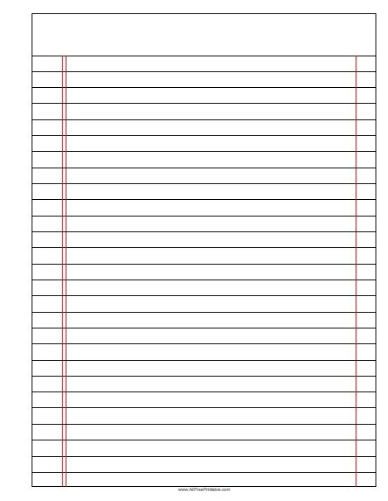






Making Soluble Salts
Read Now
Sunday, 18 January 2026
Making Soluble Salts
Task:
Complete the Read Now by:
Stick in the sheet.
Using a highlighter as you read to identify key terms.
Answer the first four recall questions under the sheet in your book.
Answer the stretch question
Making Soluble Salts
Making Soluble Salts
Aim High | Work Together | Be Kind | Lead the Way

Slide 2
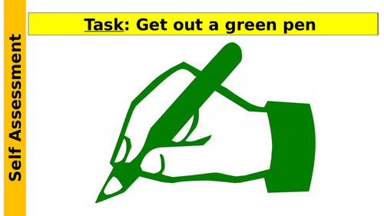
Read Now
Aim High | Work Together | Be Kind | Lead the Way
Aim High | Work Together | Be Kind | Lead the Way

Slide 3
Read Now
MARK SCHEME
Markscheme not available.
Aim High | Work Together | Be Kind | Lead the Way
Aim High | Work Together | Be Kind | Lead the Way

Slide 4
Daily Review
Follow your teachers instructions:
“When I say go show me a MWB and a MWB Pen”
You will have 10 seconds for each question.
Hold your MWB in the Ready position
“Show me”
You need to score 70% to pass
Subtitle ‘test score’ ?/10
Aim High | Work Together | Be Kind | Lead the Way
Notes:
Teachers remember to input the quiz score

Slide 5
MWB Quiz
What is the name of an organism that eats other organisms?
What is used to increase the yield of a farmer’s field?
What is the term for an extreme food shortage?
What is the term for having enough food to feed a population?
What is the process of minerals moving through the soil due to rain fall?

Slide 6
MWB Quiz
What is the name of an organism that eats other organisms? Predator
What is used to increase the yield of a farmer’s field? Fertiliser
What is the term for an extreme food shortage? Famine
What is the term for having enough food to feed a population? Food security
What is the process of minerals moving through the soil due to rain fall? Leaching

Slide 7
Objectives
• 17/04/2024
• Making Soluble Salts
• C3.2.10
• C3.2.1 Prior Knowledge Review
• C3.2.2 Relative Formula Mass
• C3.2.3 Percentage by Mass
• C3.2.4 Conservation of Mass
• C3.2.5 Balancing Equations
• C3.2.6 Uncertainty
• C3.2.7 Introducing Concentration
• C3.2.8 Concentration Calculations
• C3.2.9 Soluble Salts
• C3.2.10 Making Soluble Salts
• C3.2.11 Making Soluble Salts 2
Lesson 1
Lesson 2
Lesson 3
Lesson 4
Lesson 5
Lesson 6
Lesson 8
Lesson 9
Lesson 10
Lesson 7
Aim High | Work Together | Be Kind | Lead the Way
Notes:
11.2 5.19

Slide 8
Exposition
Aim High | Work Together | Be Kind | Lead the Way
Notes:
11.31 1.42
11.2 4.35

Slide 9
Exposition
Aim High | Work Together | Be Kind | Lead the Way
Notes:
11.31 1.42
11.2 4.35

Slide 10
Exposition
Aim High | Work Together | Be Kind | Lead the Way
Notes:
11.2 1.43
11.2 1.7

Slide 11
Deliberate Practice
Big Question:
Aim High | Work Together | Be Kind | Lead the Way

Slide 12

Deliberate Practice
Aim High | Work Together | Be Kind | Lead the Way

Slide 13
Exit Ticket
Which of the following is a precaution when preparing a soluble salt?
A. Concentrated acid is corrosive.
B. Allow hot glassware to cool before touching it.
C. Concentrated acid can cause chemical burns.
After which process/technique are you left with a copper oxide residue?
A. crystallisation
B. evaporation
C. filtration
Once the copper sulfate solution is prepared, why do we evaporate off some water using the Bunsen burner?
A. to make the solution stronger
B. to make the reaction happen faster
C. to make the solution more concentrated
Aim High | Work Together | Be Kind | Lead the Way

